Slide 1
FESTIM Fellowship Work Plan E. Yildirim

Slide 2
Overview
Summer Cohort starting in mid-June
20 hrs/week expected commitment
2 trips favored for start and mid progress, with possible final wrap up trip at the end

Slide 3
Structure
Stage | Weeks | Focus | Status
Stage 1 | 1-4 | Pebble Model Refinement -- validated, reproducible FESTIM model of tritium release from lithium ceramics | Core
Stage 2 | 5-8 | Helium Purge Loop System Model -- system-level TES model integrating pebble outputs into purge loop behaviour | Core
Stage 3 | 9-10 (conditional) | Plant-Scale Surrogate -- reduced-order model for integration into PathSim/FactorySim fuel cycle frameworks | Stretch only

Slide 4
Stage 1 – Pebble Model Evaluation
Week | Theme | Key Activities | Outcome
1 | Model Audit and Onboarding | Review existing pebble model against FESTIM best practices. Identify parameter gaps. Establish reproducibility standards: version control, run configuration, output structure. Initial engagement with FESTIM development team. | Documented model audit; parameter gap list; reproducibility baseline established
2 | Physics Refinement | Refine temperature-dependent transport parameters. Improve sweep gas condition sensitivity. Incorporate irradiation history effects. Work with the team on best-practice parameterisation approaches. | Updated model with improved physics fidelity; parameters documented with sources and confidence levels
3 | Uncertainty and Experimental Coupling | Apply team-recommended uncertainty handling approaches. Structure model outputs for comparison against measured data. Align output formats with H2 laboratory rig data. Review LIBRA experimental setup experience. | Uncertainty framework in place; model structured and ready to receive experimental data when available
4 | Benchmarking and Stage 1 Sign-off | Benchmark against published lithium ceramic release data. Document validation status and remaining gaps. | Benchmarked pebble-scale FESTIM model; benchmarking report; Stage 1 deliverable complete

Slide 5
Stage 2 – Pure Loop Model
Week | Theme | Key Activities | Outcome
5 | Architecture and Setup | Design helium purge loop model structure, small volume simulation. Understand FESTIM best practice for multi-component system-scale simulations. Define purge loop geometry and component definitions. | Purge loop architecture documented; FESTIM system model scaffolding in place
6 | Core Model Build | Implement conventional sweep gas circuit with getter bed extraction. Model tritium partial pressure evolution blanket and purge loop. Frame effects of pebble mobilization (gravity fed). | Working purge loop model; baseline tritium partial pressure profiles generated
7 | Sensitivity and Operating Conditions | Parametric study of extraction efficiency vs. operating conditions. Assess effects of pebble bed packing and network geometry on bulk release behaviour. Assess flow conditions for pebbles themselves. | Sensitivity results; identification of key design levers for TES operating conditions
8 | Cycling Simulations and Stage 2 Sign-off | Run transient cycling simulations to assess pebble performance under load-following conditions. Package results for Infinity II TES design trade studies. | Cycling simulation results; Stage 2 deliverable packaged for the Infinity II design team

Slide 6
Stage 3
PathSim / Factory Style Model
Looking at how upstream and downstream systems interplay
E.g. Blanket, Extraction, HX
Some of these could be analytical solutions, or FESTIM models themselves
Interesting effects would be:
Recirculating pebble tritium concentration
Gettering / permeating downstream
Dynamic control

Slide 7
Visualization
Stage 1
1D Model verified vs. 3D for pebble release

Slide 8
Visualization
Stage 1
Stage 2
Sweep Gas + Pebble Recirc.
1D Model verified vs. 3D for pebble release

Slide 9
Visualization
Stage 1
Tritium Extraction
Stage 2
Stage 3
Sweep Gas + Pebble Recirc.
1D Model verified vs. 3D for pebble release
Heat Exchanger

Slide 10
How FESTIM will be used

Slide 11
Utilization in T1E workflow
FESTIM will be integrated into system where there are no existing analytical solutions, and transient work is desired
The fellowship will allow us to build this up for the pebbles, but also give us the workflow for other systems
These models will always need to be feeding process models at the higher level, so that integration will be key
Similarly – the length scales of the components themselves e.g. blankets, is very large, therefore understand how to translate through the length scales will be key, in addition to the time scales

Slide 13
New Section
Use this slide to introduce a new section or topic.

Slide 14
New Section

Slide 15
General Content Slide
Fill this slide with your content
Press tab for a sub-bullet
Create a new sub-bullet then press and hold shift + tab…
…To come back here!

Slide 16
Text-only Slide
Is your slide only text? Want it to look cool?
Use this slide when you have a wall of text but need some visual interest

Slide 17
Content + Subtitle Slide
This is a subtitle about the content of this slide
Now expand upon the topic in the subtitle, etc.

Slide 18
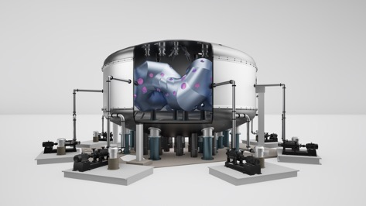
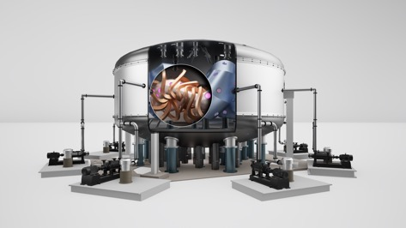
Content + Images Slide
Fill this slide with you content
Press tab for a sub-bullet
Create a new sub-bullet then press and hold shift + tab…
…To come back here!

Slide 19
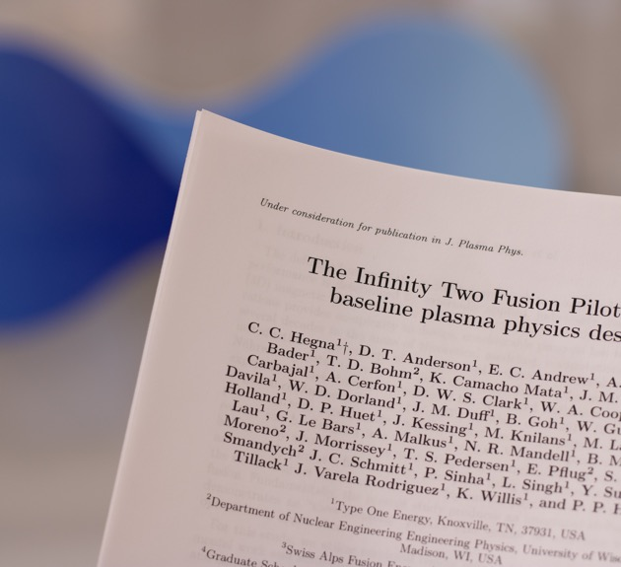
Content + Image Slide
When you only have one image, try to format it like this
You can use this slide and just change the image
Select the image on the right
Go to “Picture Format” in the upper menu
Toward the left-hand side look for “Change Picture”
Select “From a File…” and add your own image

Slide 20
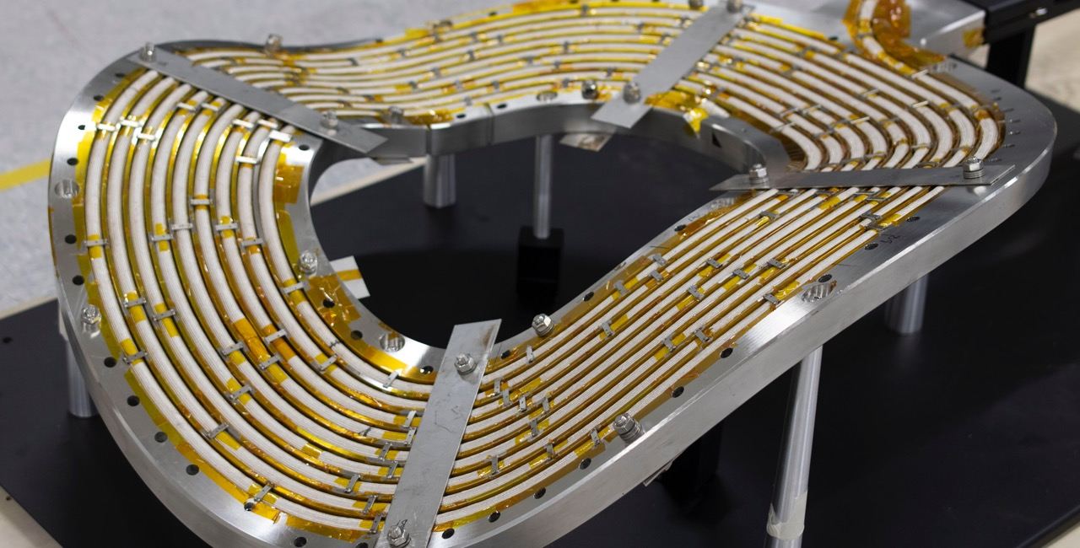

Highlight Image + Notes
Use a large photo to emphasize your point
To change the image on this slide:
Select the image on the right
Go to “Picture Format” in the upper menu
Toward the left-hand side look for “Change Picture”
Select “From a File…” and add your own image

Slide 21
Timeline Slide
Recap past events and accomplishments
State quick facts
Or highlight an upcoming milestone
2025 | 2026 | 2027 | 2028 | 2029 | 2030 | 2030s…

Slide 22
Highlight Slide 1
Milestone #1
List things
More things
Even more things
Milestone #1
List things
More things
Even more things
Milestone #1
List things
More things
Even more things
Milestone #1
List things
More things
Even more things
Milestone #1
List things
More things
Even more things
Milestone #1
List things
More things
Even more things

Slide 23
Highlight Slide 2
Milestone #1
List things
More things
Even more things
Milestone #1
List things
More things
Even more things
Milestone #1
List things
More things
Even more things
Milestone #1
List things
More things
Even more things
Milestone #1
List things
More things
Even more things
Milestone #1
List things
More things
Even more things

Slide 24
Big Ideas
Idea #1
Idea #2
List things
More things
Even more things
List things
More things
Even more things

Slide 25
Big Ideas
Idea #1
Idea #2
Idea #3
List things
More things
Even more things
List things
More things
Even more things
List things
More things
Even more things
Add the major takeaway at the bottom if applicable

Slide 26
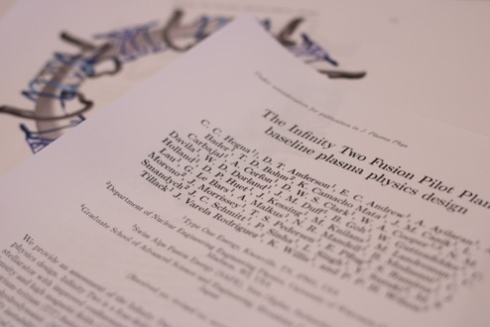
Big Ideas
Idea #1
Idea #2
List things
More things
Even more things

Slide 27
Processes
List things
Show images
List things
Show images
List things
Show images
List things
Show images

Slide 28


Meet Your Team
John Smith
Person #1
Title, ex) CTO
Title, ex) Systems Engineer
Brief description or bullet points about the individual
Person #2
Title, ex) Marketing and Communications Specialist
Jane Doe
Title, ex) Director, Fuel Cycle
Person #3
Brief description or bullet points about the individual
Title

Slide 29
Need more support?
If you need help:
Matt Miles
Go to the MarComm SharePoint Page for past decks and ideas
Check out all the resources on that page while you’re there
Reach out to a member of MarComm if you still have questions remaining
SVP, Marketing and External Affairs
Celeste Cubbage
Marketing and Communications Specialist
Sarah Clark
Title

Slide 30
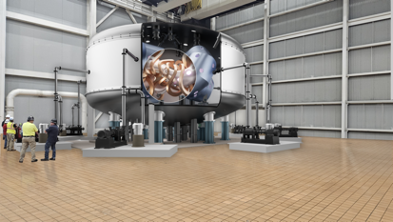


Images Approved to Use – Infinity One

Slide 31
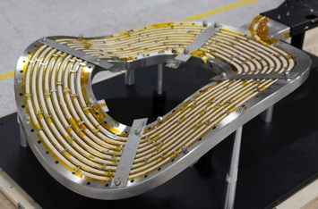
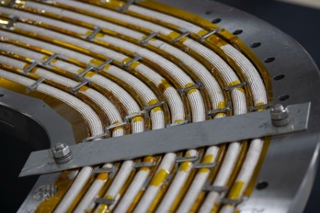
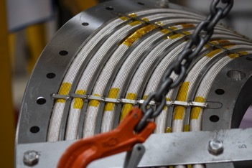
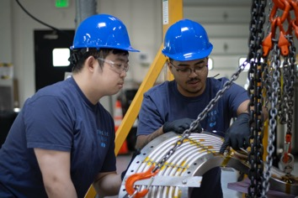
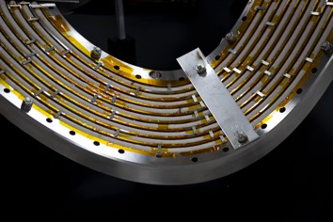
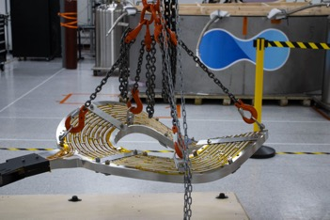
Images Approved to Use – Magnet Zero

Slide 32


Our Logos

Slide 33
Thank you!

